Slide 1
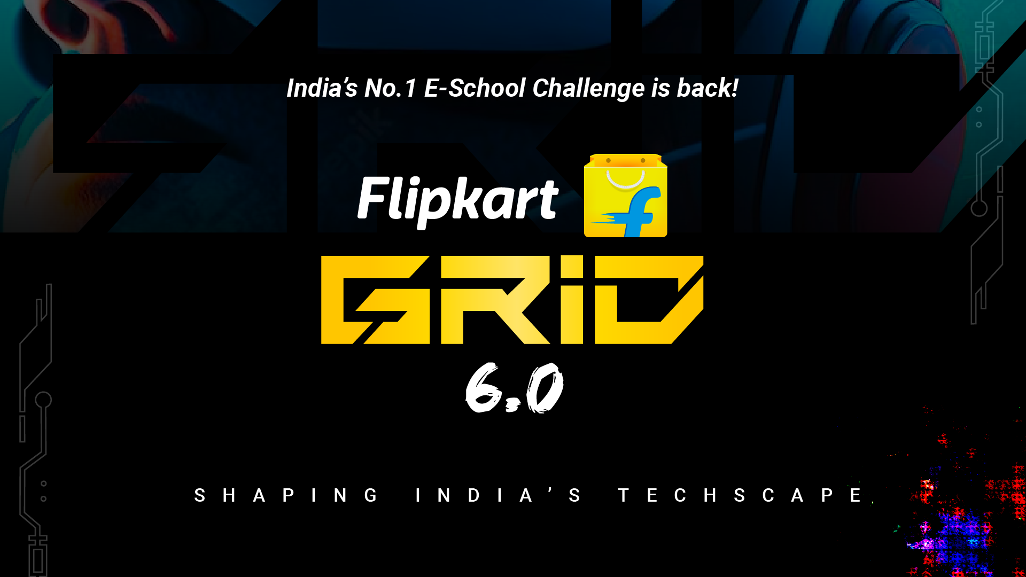
Notes:
#

Slide 2
Title: Smart Vision Solution for Freshness Detection in Fruits and Vegetables Track Name: AI/ML
Team Name: WhiteCoder Team Member:
Md Shahid Ansari (Individual Participant, Developer & Researcher)
University: Aliah University Date: 20-10-2024

Slide 3
The proposed solution addresses the challenge of detecting the freshness of fruits and vegetables using AI.
The system leverages object detection (YOLOv8) to identify different fruits and vegetables from images and then analyzes their freshness through a machine learning model based on ResNet-18.
Trained on a large dataset, the model distinguishes between fresh and rotten produce for categories like apples, bananas, and oranges.
This system is designed for real-world applications, such as automated quality control in supermarkets, warehouses, and food supply chains, offering an efficient solution for classifying produce based on its freshness.

Slide 4
Technology Used:
Object Detection: YOLOv8 for detecting fruits and vegetables in front and back images.
Classification Model: ResNet-18 fine-tuned for freshness classification of six categories (fresh/rotten apples, bananas, and oranges).
Programming Languages: Python
Libraries: PyTorch, torchvision, OpenCV, tqdm
Hardware Specifications:
GPU: CUDA (if available) for faster training
CPU: Intel/AMD-based system
Items Used to Train the Model:
Dataset: Large collection of fresh and rotten fruit images in various orientations
Classes: freshapples, freshbanana, freshoranges, rottenapples, rottenbanana, rottenoranges
Data Augmentation: Random rotations, rescaling, and normalization to improve model robustness.
GitHub Code Link: Flipkart Robotics.git
Video Simulation: [Insert Google Drive Video Link] *banaunga to de dunga

